Slide 1

Led Light project

Slide 2
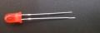
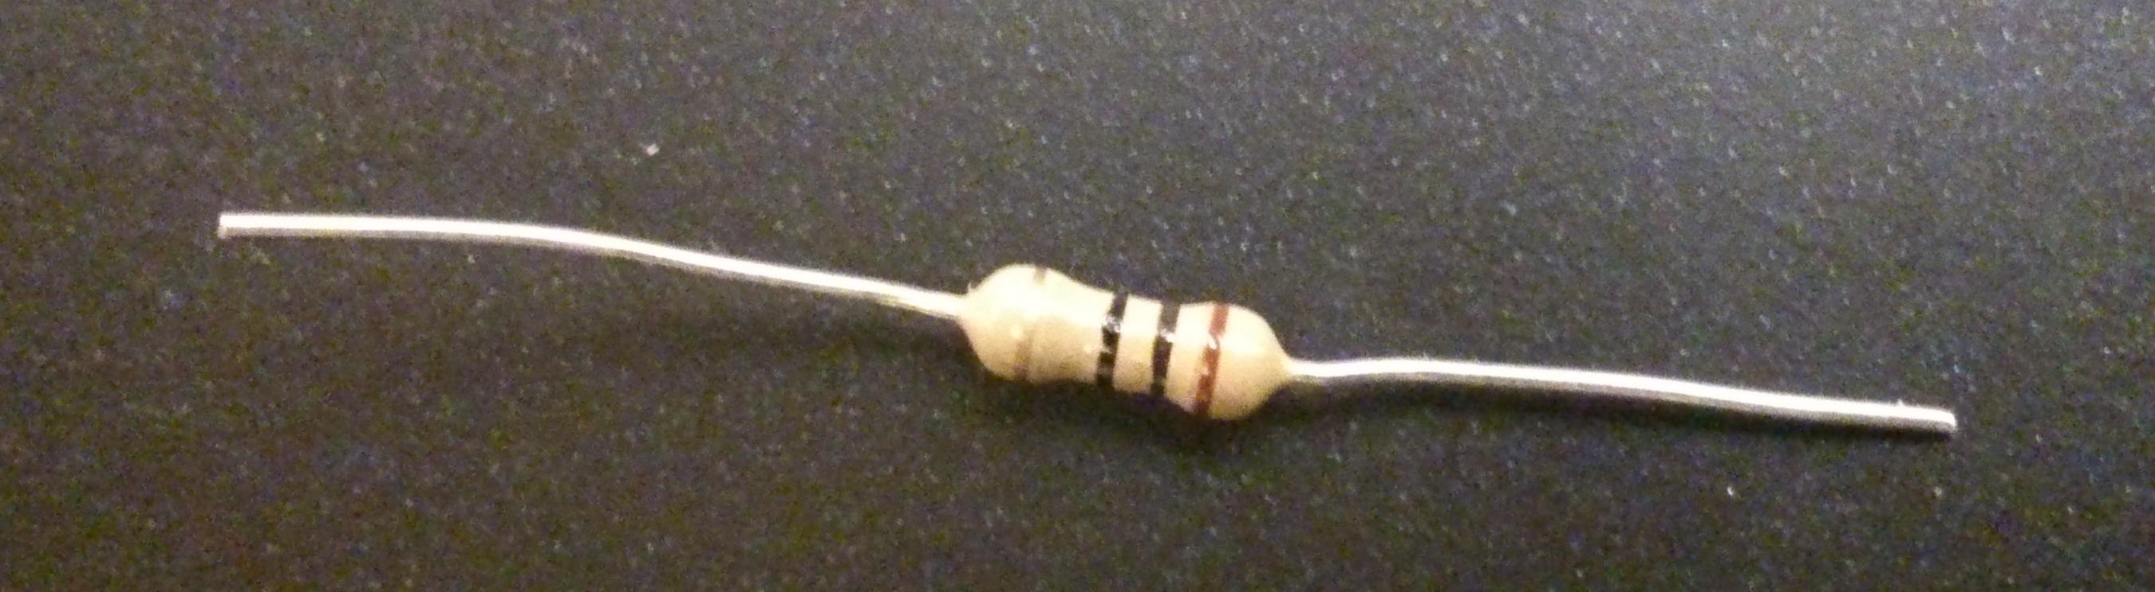
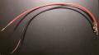
What we Need?
1 LED
1 Resistor
2 Wires

Slide 3
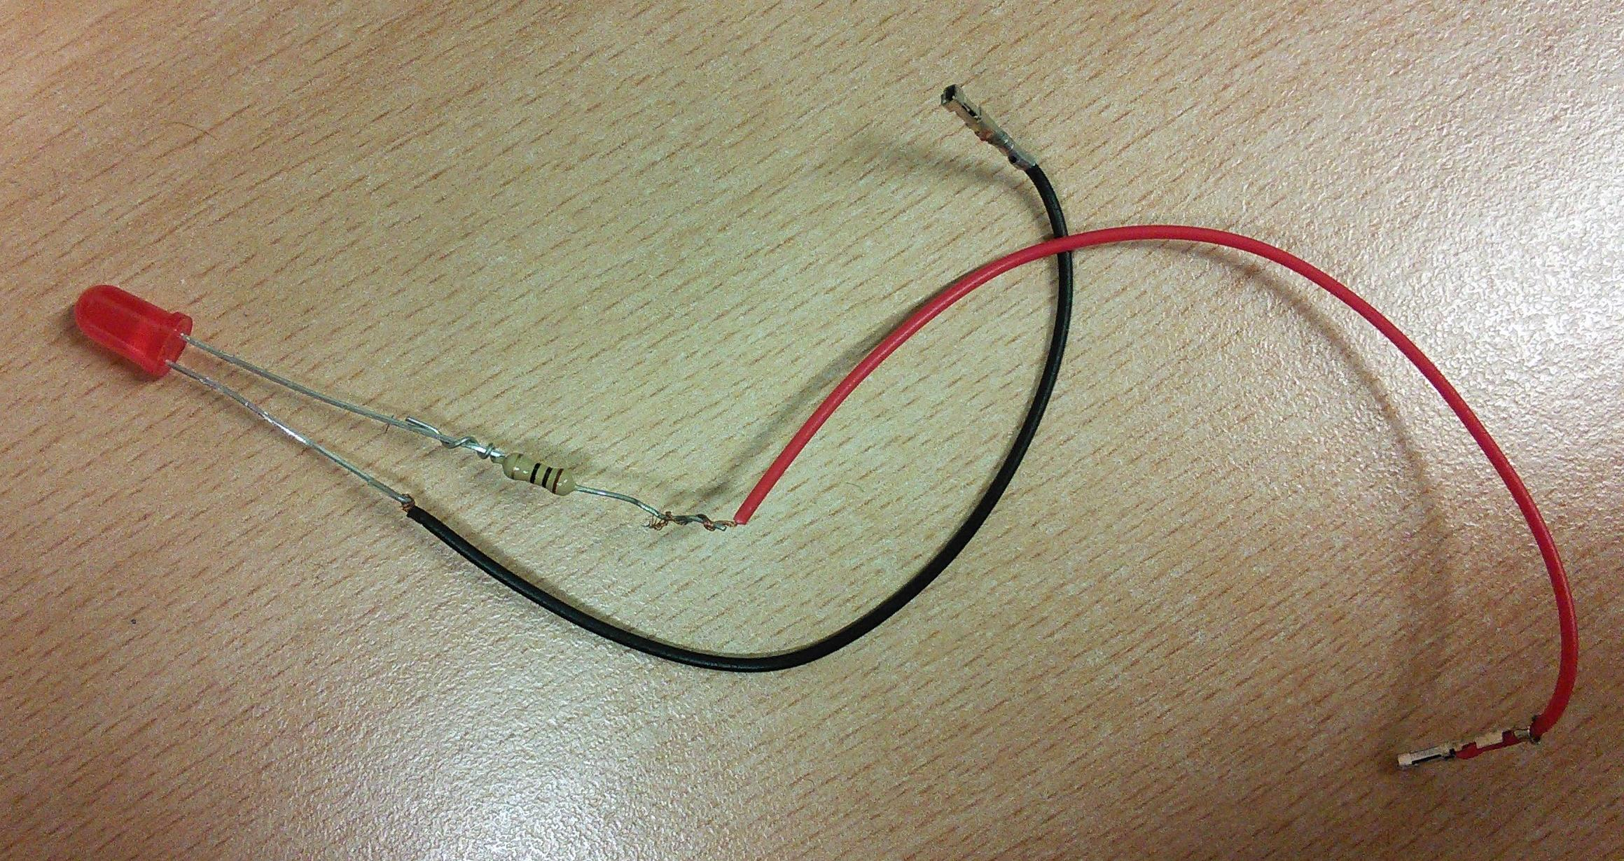
Connect the resistor to the long leg
Long leg
Short leg

Slide 4
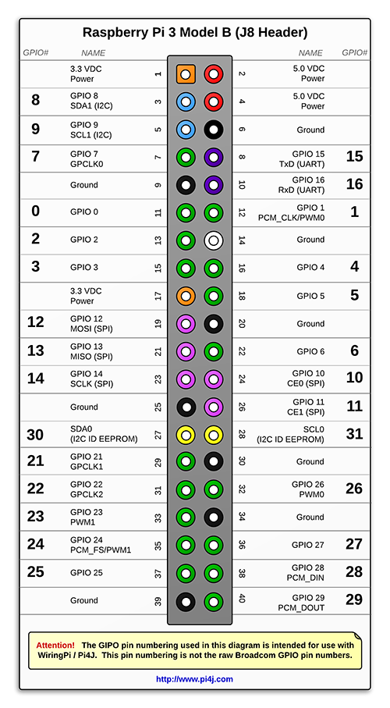
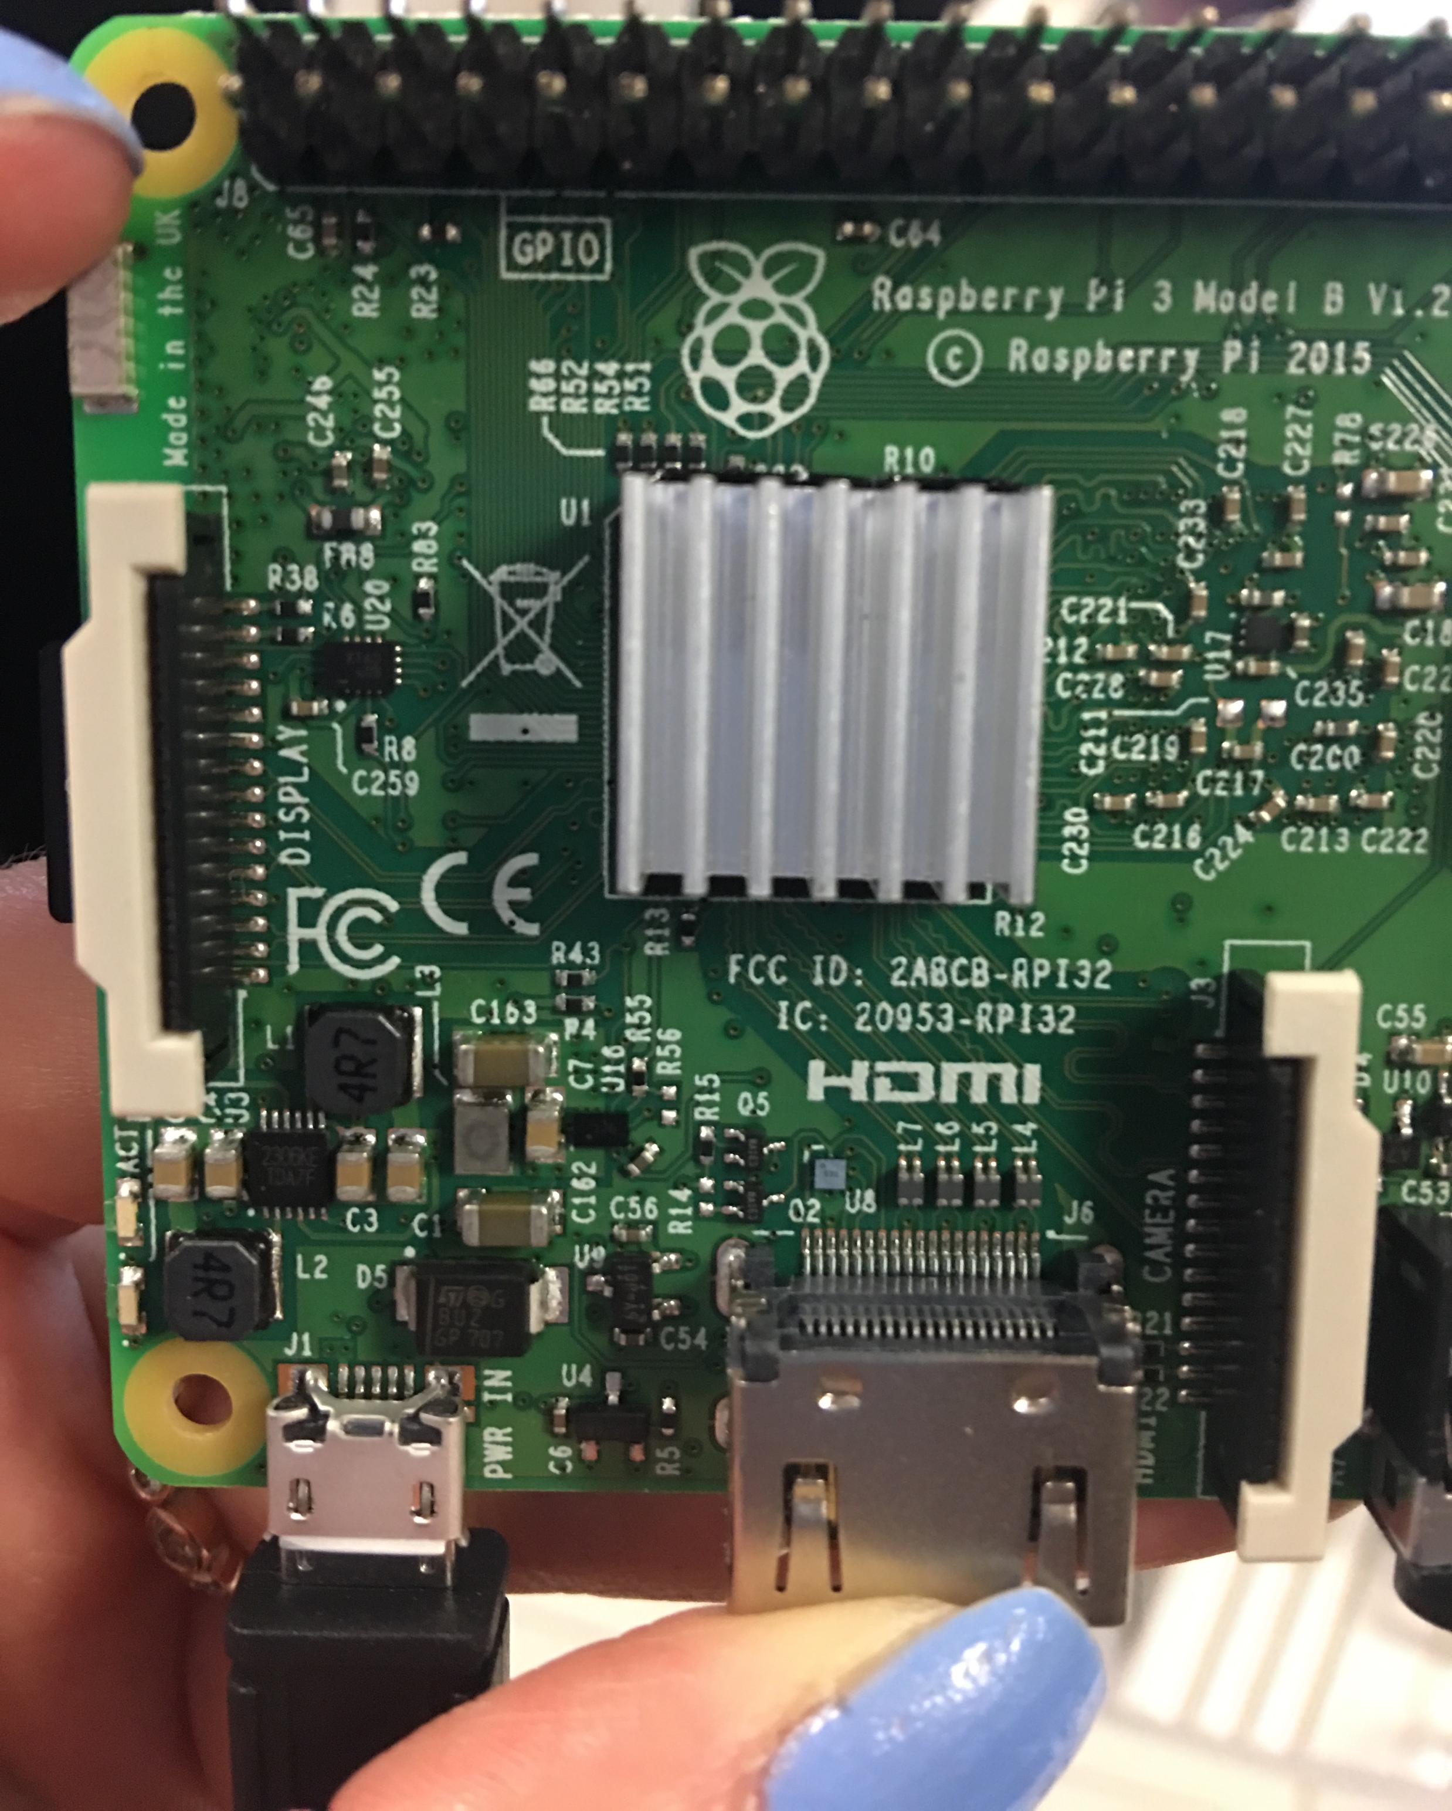
Take off your raspberry pi out of the box
J8
Connect the leg without resistor to the 3rd pin on the right
Connect the leg with the resistor to the 6th pin on the right

Slide 5
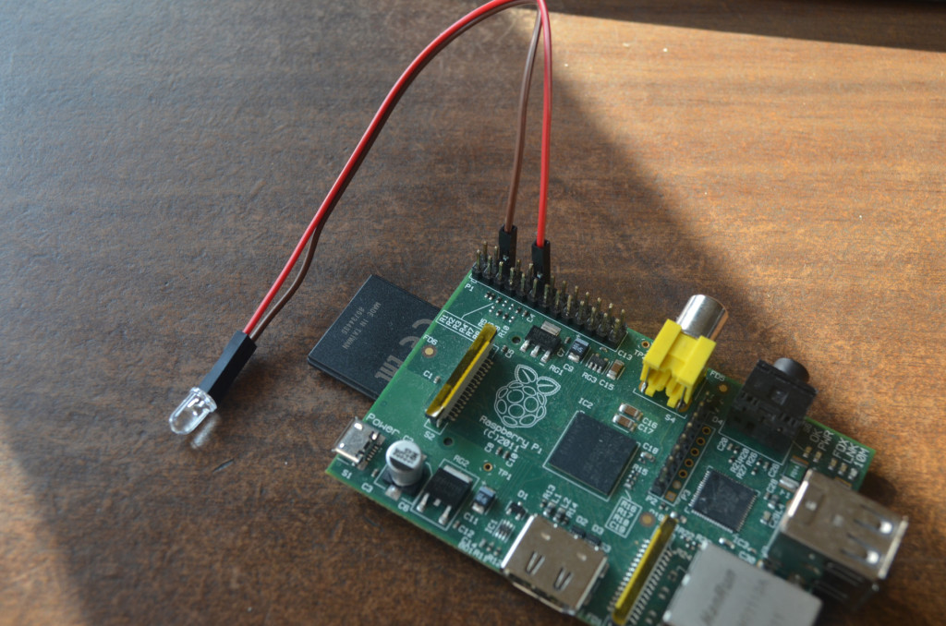
TEST Your WIRE connection
Connect the long leg to 1st and short leg 3th pins on the right(outer side of your PI)
1
3

Slide 6
Connect the LEGS TO the 3rd and 6th pins on the right
3
6

Slide 7
TURNING THE LIGHT on WITH CODE
https://tinyurl.com/gencyber-sa
Open day2_ledlight FOLDER
DOWNLOAD PI4J.zip AND EXTRACT WITH THE SAME NAME
PUT PI4J FOLDER UNDER ON YOUR DESKTOP

Slide 8
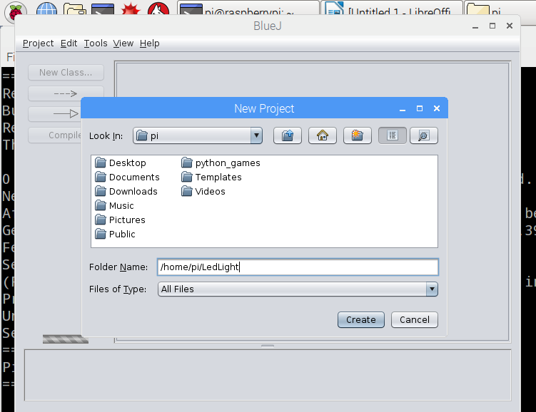
TURNING THE LIGHT on WITH CODE
Open BlueJ Editor
Create A New PROJECT WITH A Name you want (LedLight)

Slide 9
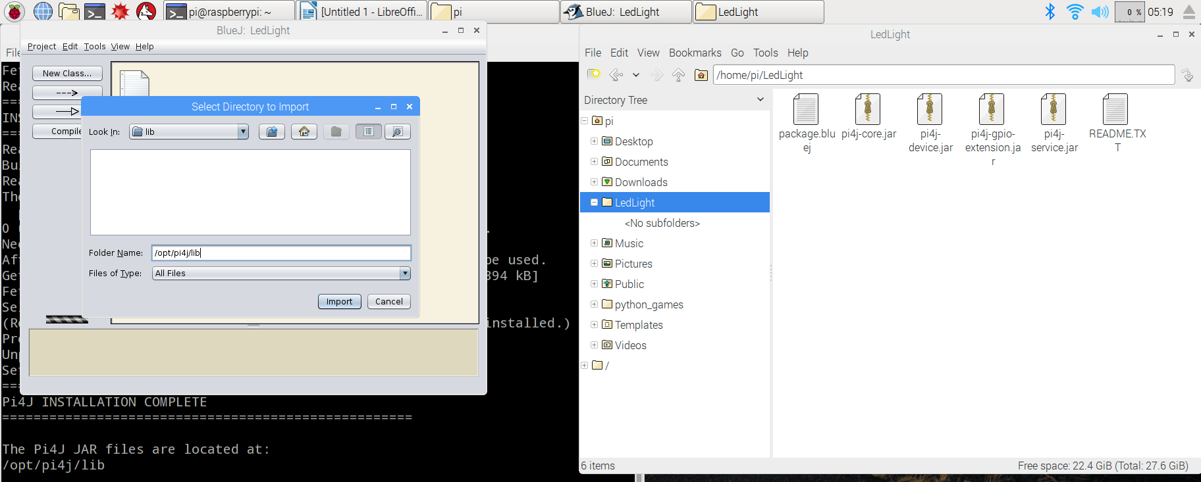
TURNING THE LIGHT on WITH CODE
CLICK PROJECT→ IMPORT >> NAVIGATE TO /HOME/PI/DESKTOP/PI4J/LIB >> CLICK IMPORT

Slide 10
TURNING THE LIGHT on WITH CODE
Create a NEW CLASS
1) turn on the LED for 2 seconds
2) turn off the LED and wait 1 second
3) turn on the LED for 1 second

Slide 11
CODE LIBRARY
Object-Oriented → code reuse

